Slide 1
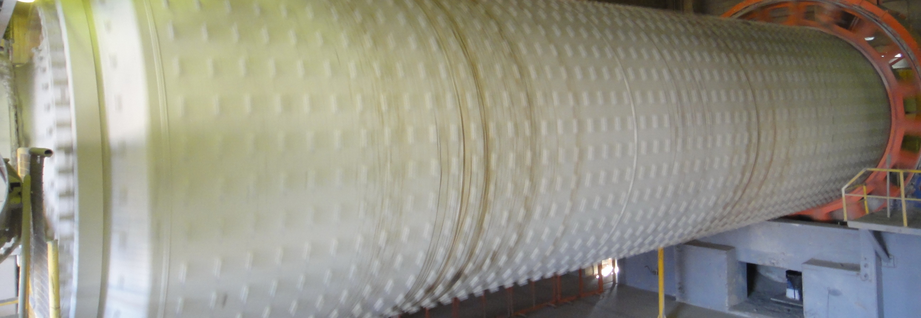
Ball Mill Optimisation Case Study
Process and Progress of Grinding

Slide 2
Ball Mill Optimization Tools - Outline
Spread sheets
Ball Mill Data Sheet
Ball Mill Performance
Mill Calculation
Longitudinal Sieving
Ball Charge Optimization
…these tools are a MUST for any PPE

Slide 3
Mill Data Sheet
Basic data for any report
Always to be used as annex 1

Slide 4
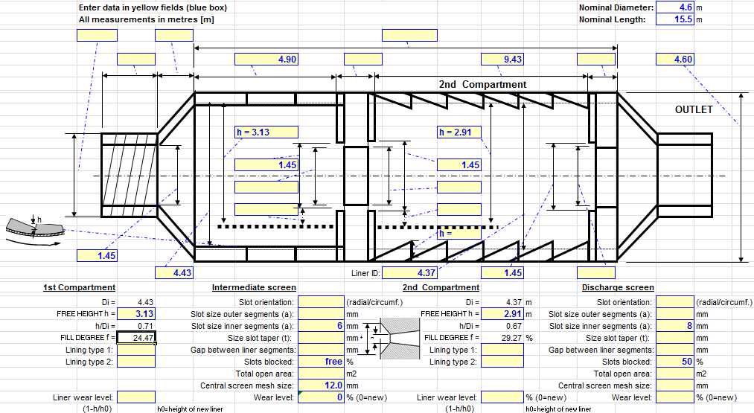
Mill Internals
Documents mainly the internal dimensions of mill and ball charge

Slide 5
Mill Performance Summary
Characterizes BM condition for one situation (product, feed composition,..)
Always to be used as annex 2

Slide 6
Mill Calculation Sheet
Explains the absorbed power of the BM
Important for any modification concerning absorbed power (ball charge, mill speed, chamber lengths)

Slide 7
Task 1: Mill Calculation
What is the maximum filling degree of CM4 without modification of the mill internals?
What is the absorbable power of the mill when topping up the maximum ball charge?
What is the expected production rate of CM4 with maximum ball charge?

Slide 8
Ball charge – as reported from the last new charging

Slide 9
Longitudinal sieving result CM4 - Table

Slide 10
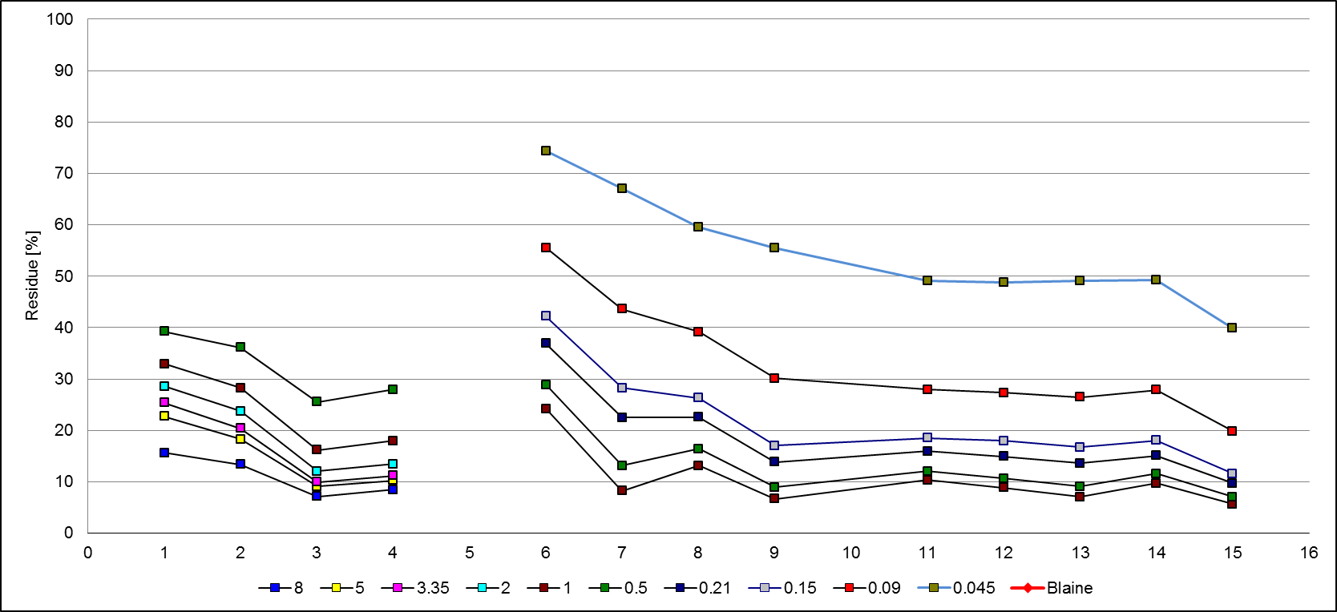
Longitudinal sieving result CM4

Slide 11
Task 2: Longitudinal Sieving
What is your opinion about the sieving result?
First chamber? Second chamber?
Which other information is required to make statements?
How could the ball charge be changed?
Chamber 1
Chamber 2

